Slide 1
Prediction of cost-sensitive bank credit risk using descriptors extracted from graphs
INF5119 : Advanced data mining techniques and application
By:
DJIEMBOU TIENTCHEU VICTOR NICO

Slide 2
Table of contents
Context
Problem
Solution idea
  Modeling of Borrowing graph
  Extracting descriptors from graphs
Presentation of the Framework
  Model
  Data
  Graph construction
  Descriptor extraction
Presentation of some results
  Visualisation
  Interpretation

Slide 3





Context

Slide 4
Problem
How can financial credit risk prediction models be improved?
  How can we overcome the lack of available data and the low quality of available data?
  Which Machine Learning model should I choose?
  How can the results of the models be explained?
  How can we assess the financial costs?

Slide 5
Solution idea
Modeling the history of bank loans in graphs
Analyze the complex relationships between loans
Extract attributes (descriptors) from the analysis and inject them into the initial dataset
Train several classic machine learning models on the new dataset
Analyze the importance coefficients of each attribute in the dataset to explain the results

Slide 6
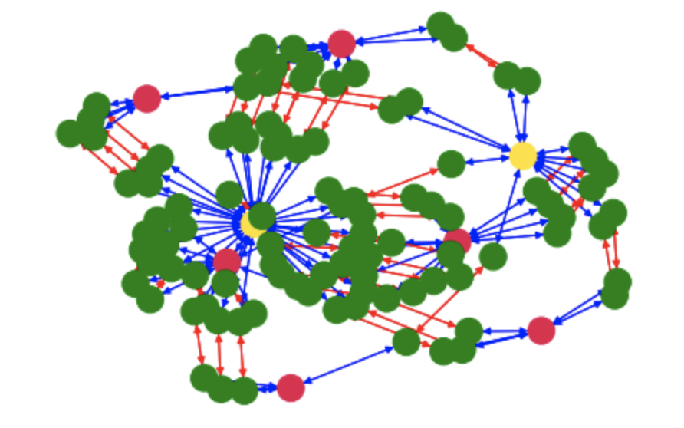
Multi-layer graph modeling

Slide 7
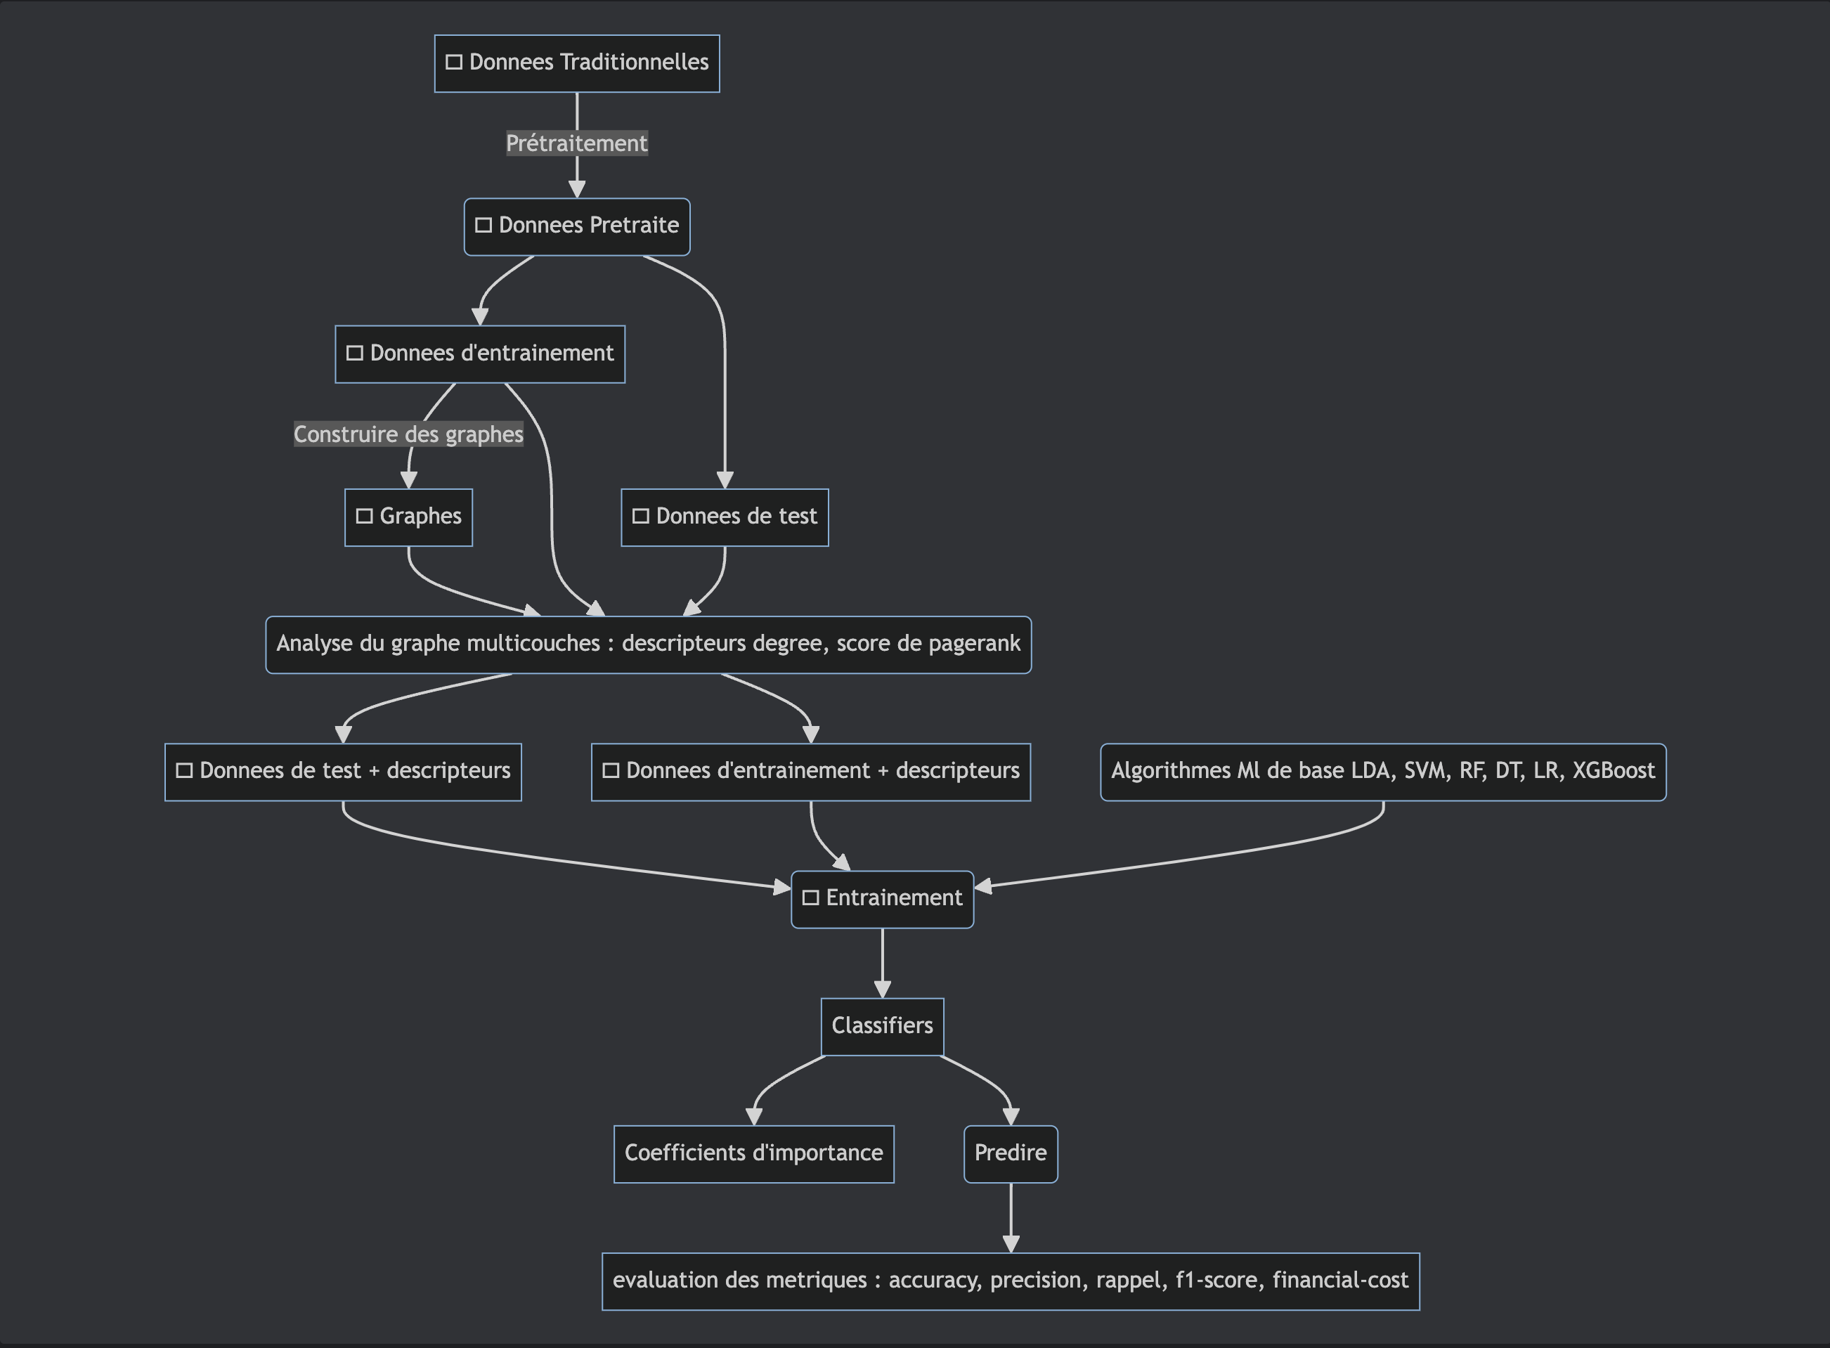
Framework

Slide 8
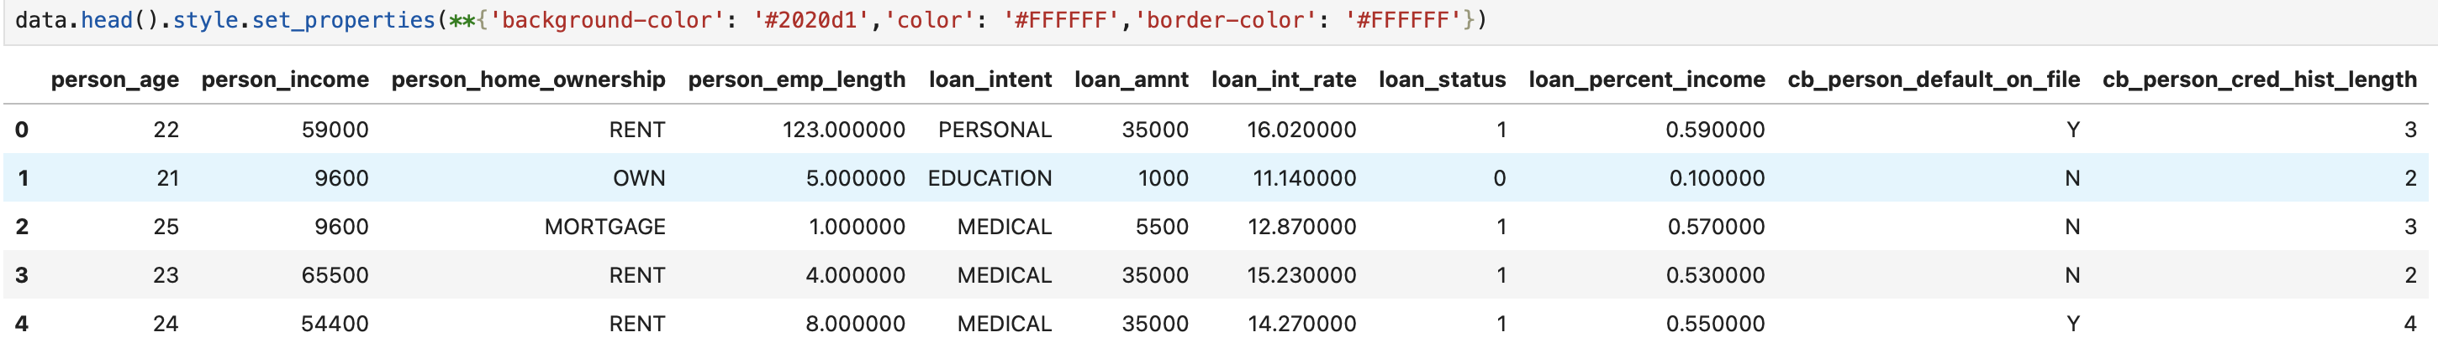
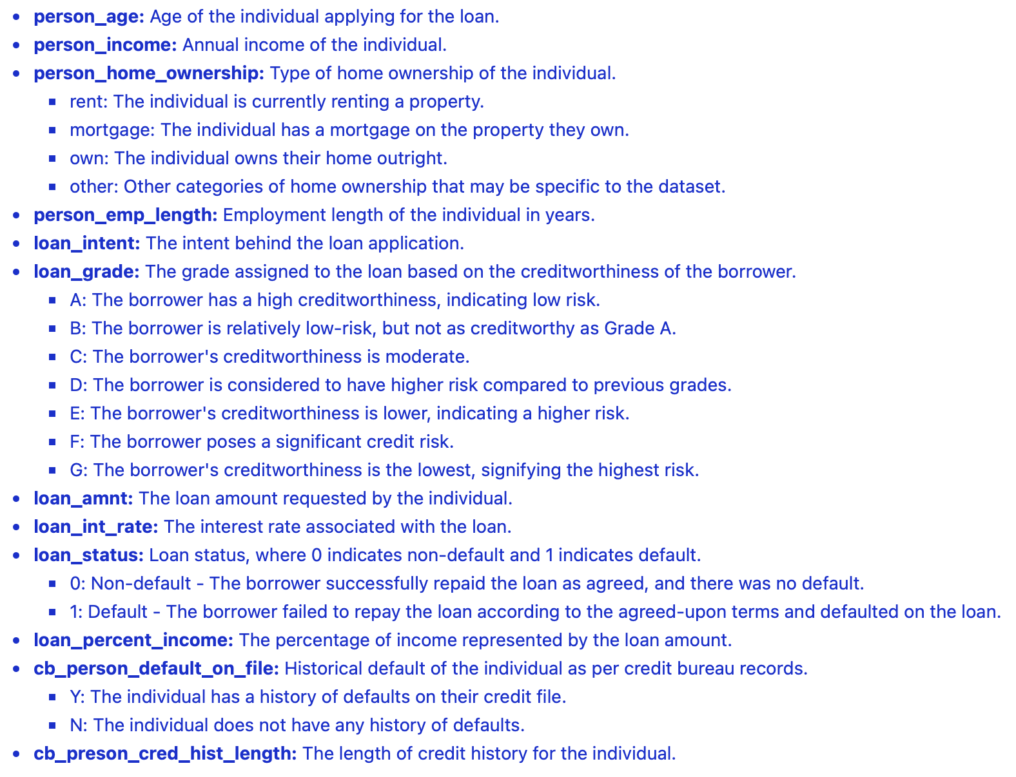
Data and Descriptions (GERMAN Dataset)

Slide 9
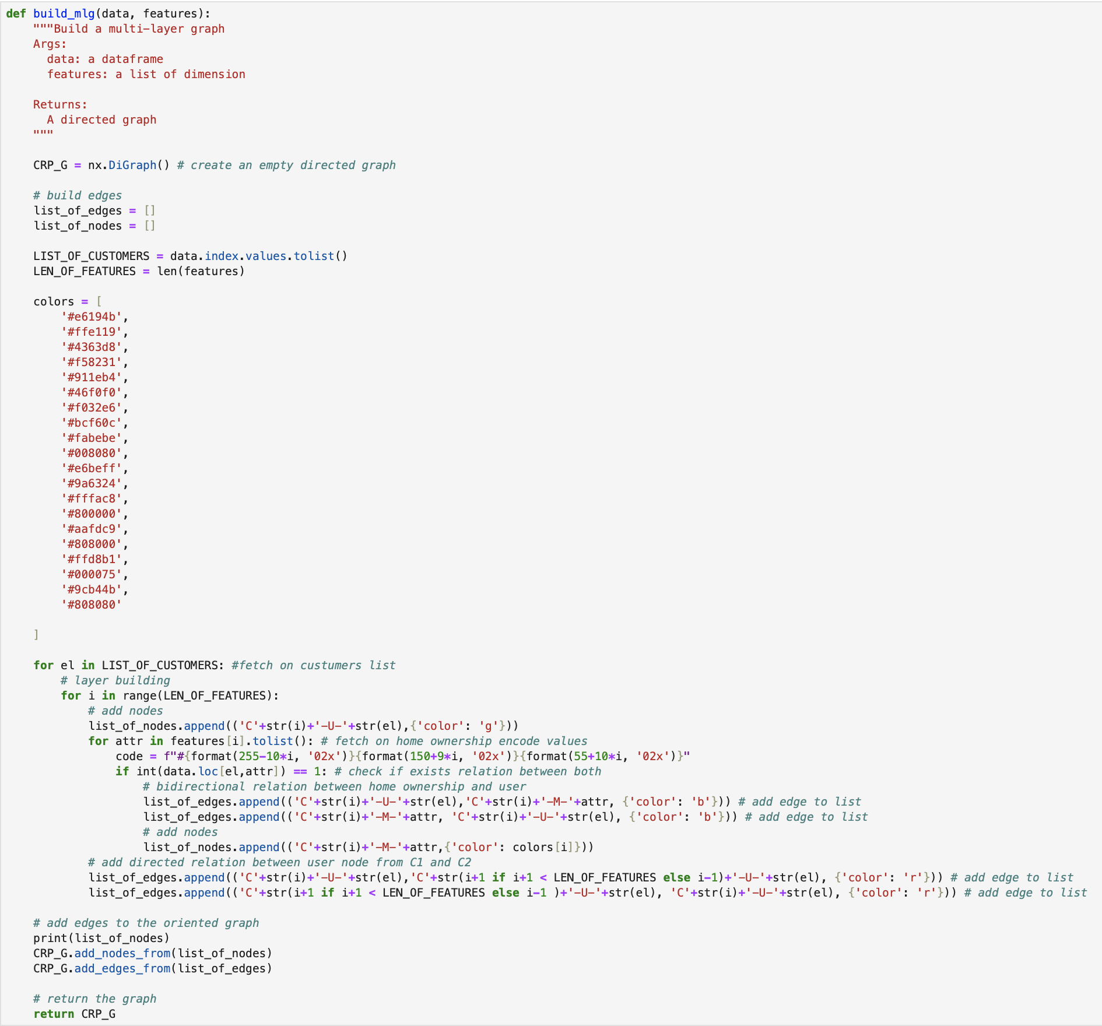
Building a multi-layer graph

Slide 10
Source Code Exploration

Slide 11
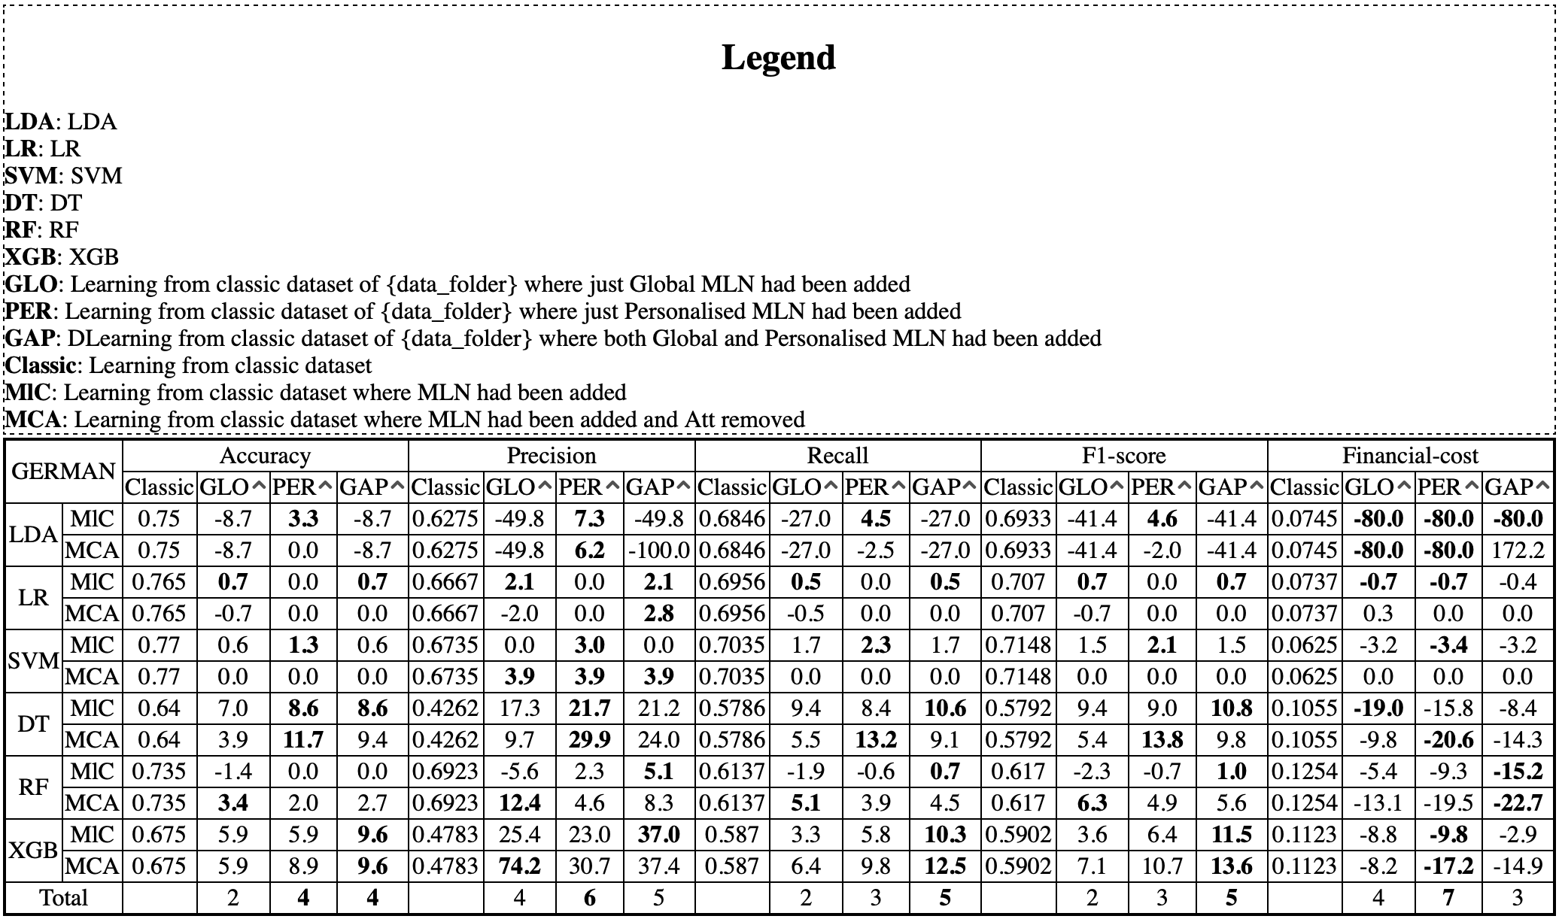
Results and interpretations

Slide 12
Thank you for your attention
By:
Victor Djiembou

